Slide 1
Explanation for the simulation results using LDLJ

Slide 2
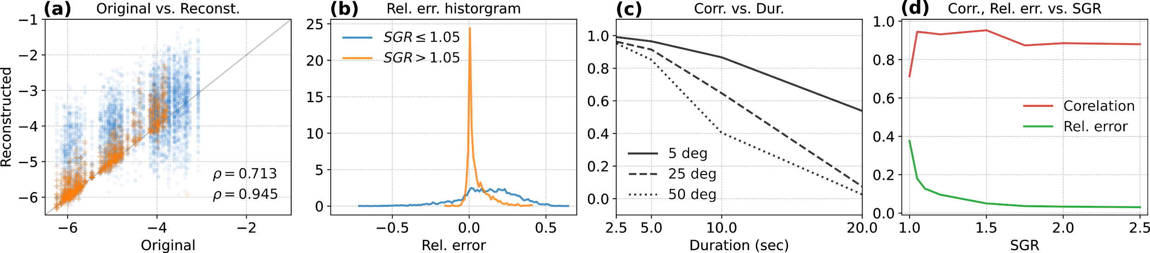
LDLJ-A applied for simulated accelerometer data
The following figure is the result obtained from the simulated accelerometer data that is reconstructed. LDLJ-A measure is applied to this data.
Why are the blue dot scattered as shown in Fig. (a)? For low values of LDLJ-A the reconstructed data overestimates smoothness, while for the higher values the smoothness values are both over- and under-estimated.

Slide 3
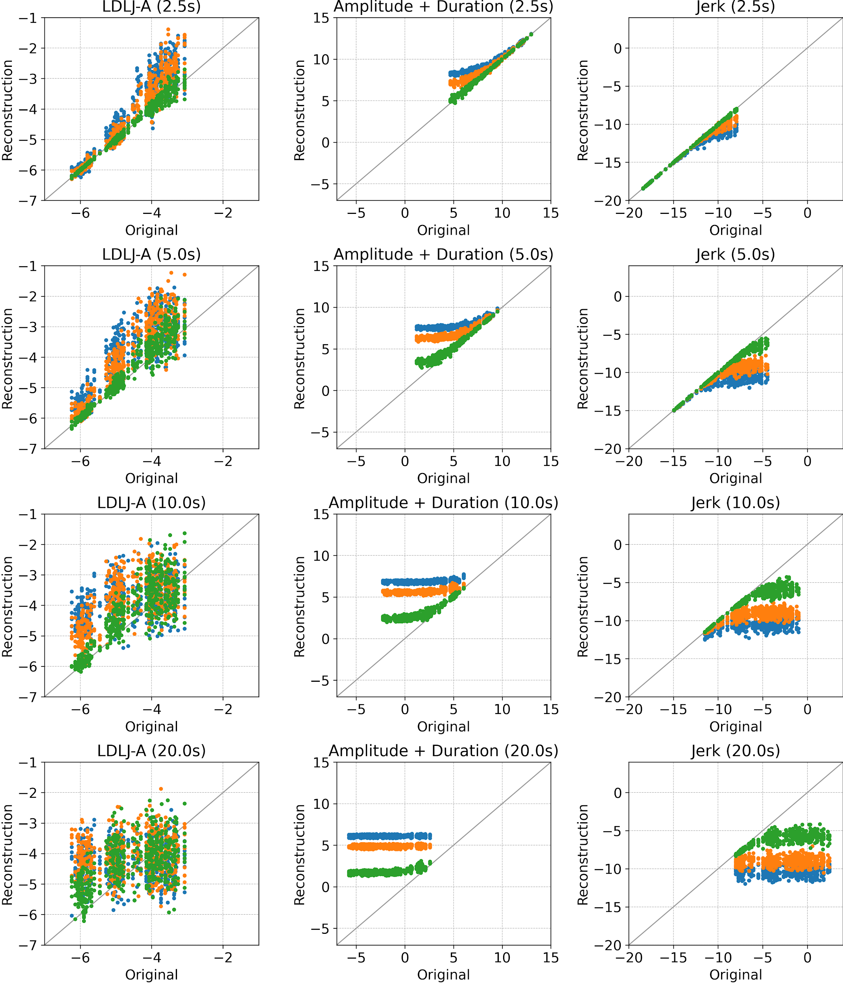
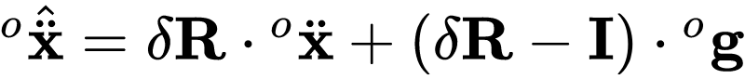
LDLJ-A terms
Increased duration results in poor estimate of all terms, and thus smoothness.
For a given duration, more reconstruction error leads to more deviation from the true value.
Amplitude term: As amplitude reduces, the deviation from the actual value increases with more reconstruction error. For low amplitudes, the amplitude term is always overestimated as gravity dominates.
Jerk term: As jerk reduces the deviation from the actual value increases with more reconstruction error. For lower jerk values, jerk is always underestimated as the jerk is dominated by the reconstruction error jerk term.

Slide 4
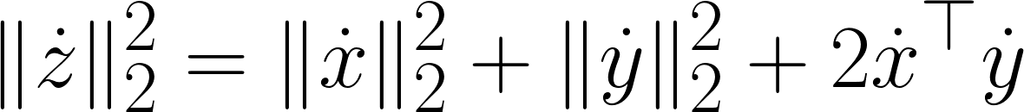
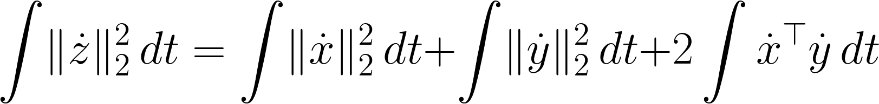
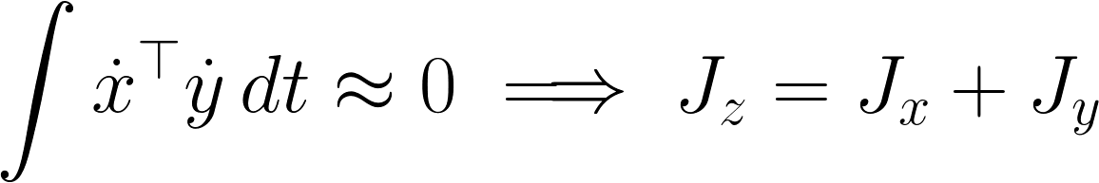
LDLJ-A terms
Why is the jerk term always underestimated? When we add two signals together, and they are independent of each other, then the means squared (m.s.) jerk will always be greater than the their individual m.s. Jerks.

Slide 5
LDLJ-A terms
Why is the amplitude term always overestimated? The amplitude depends on the nature of the movements. For movements smaller number of submovements, linear acceleration goes down. The gravity term remains the same as irrespective of the movement, thus for movement s with lolower acceleration, the gravity term dominates.

Slide 6
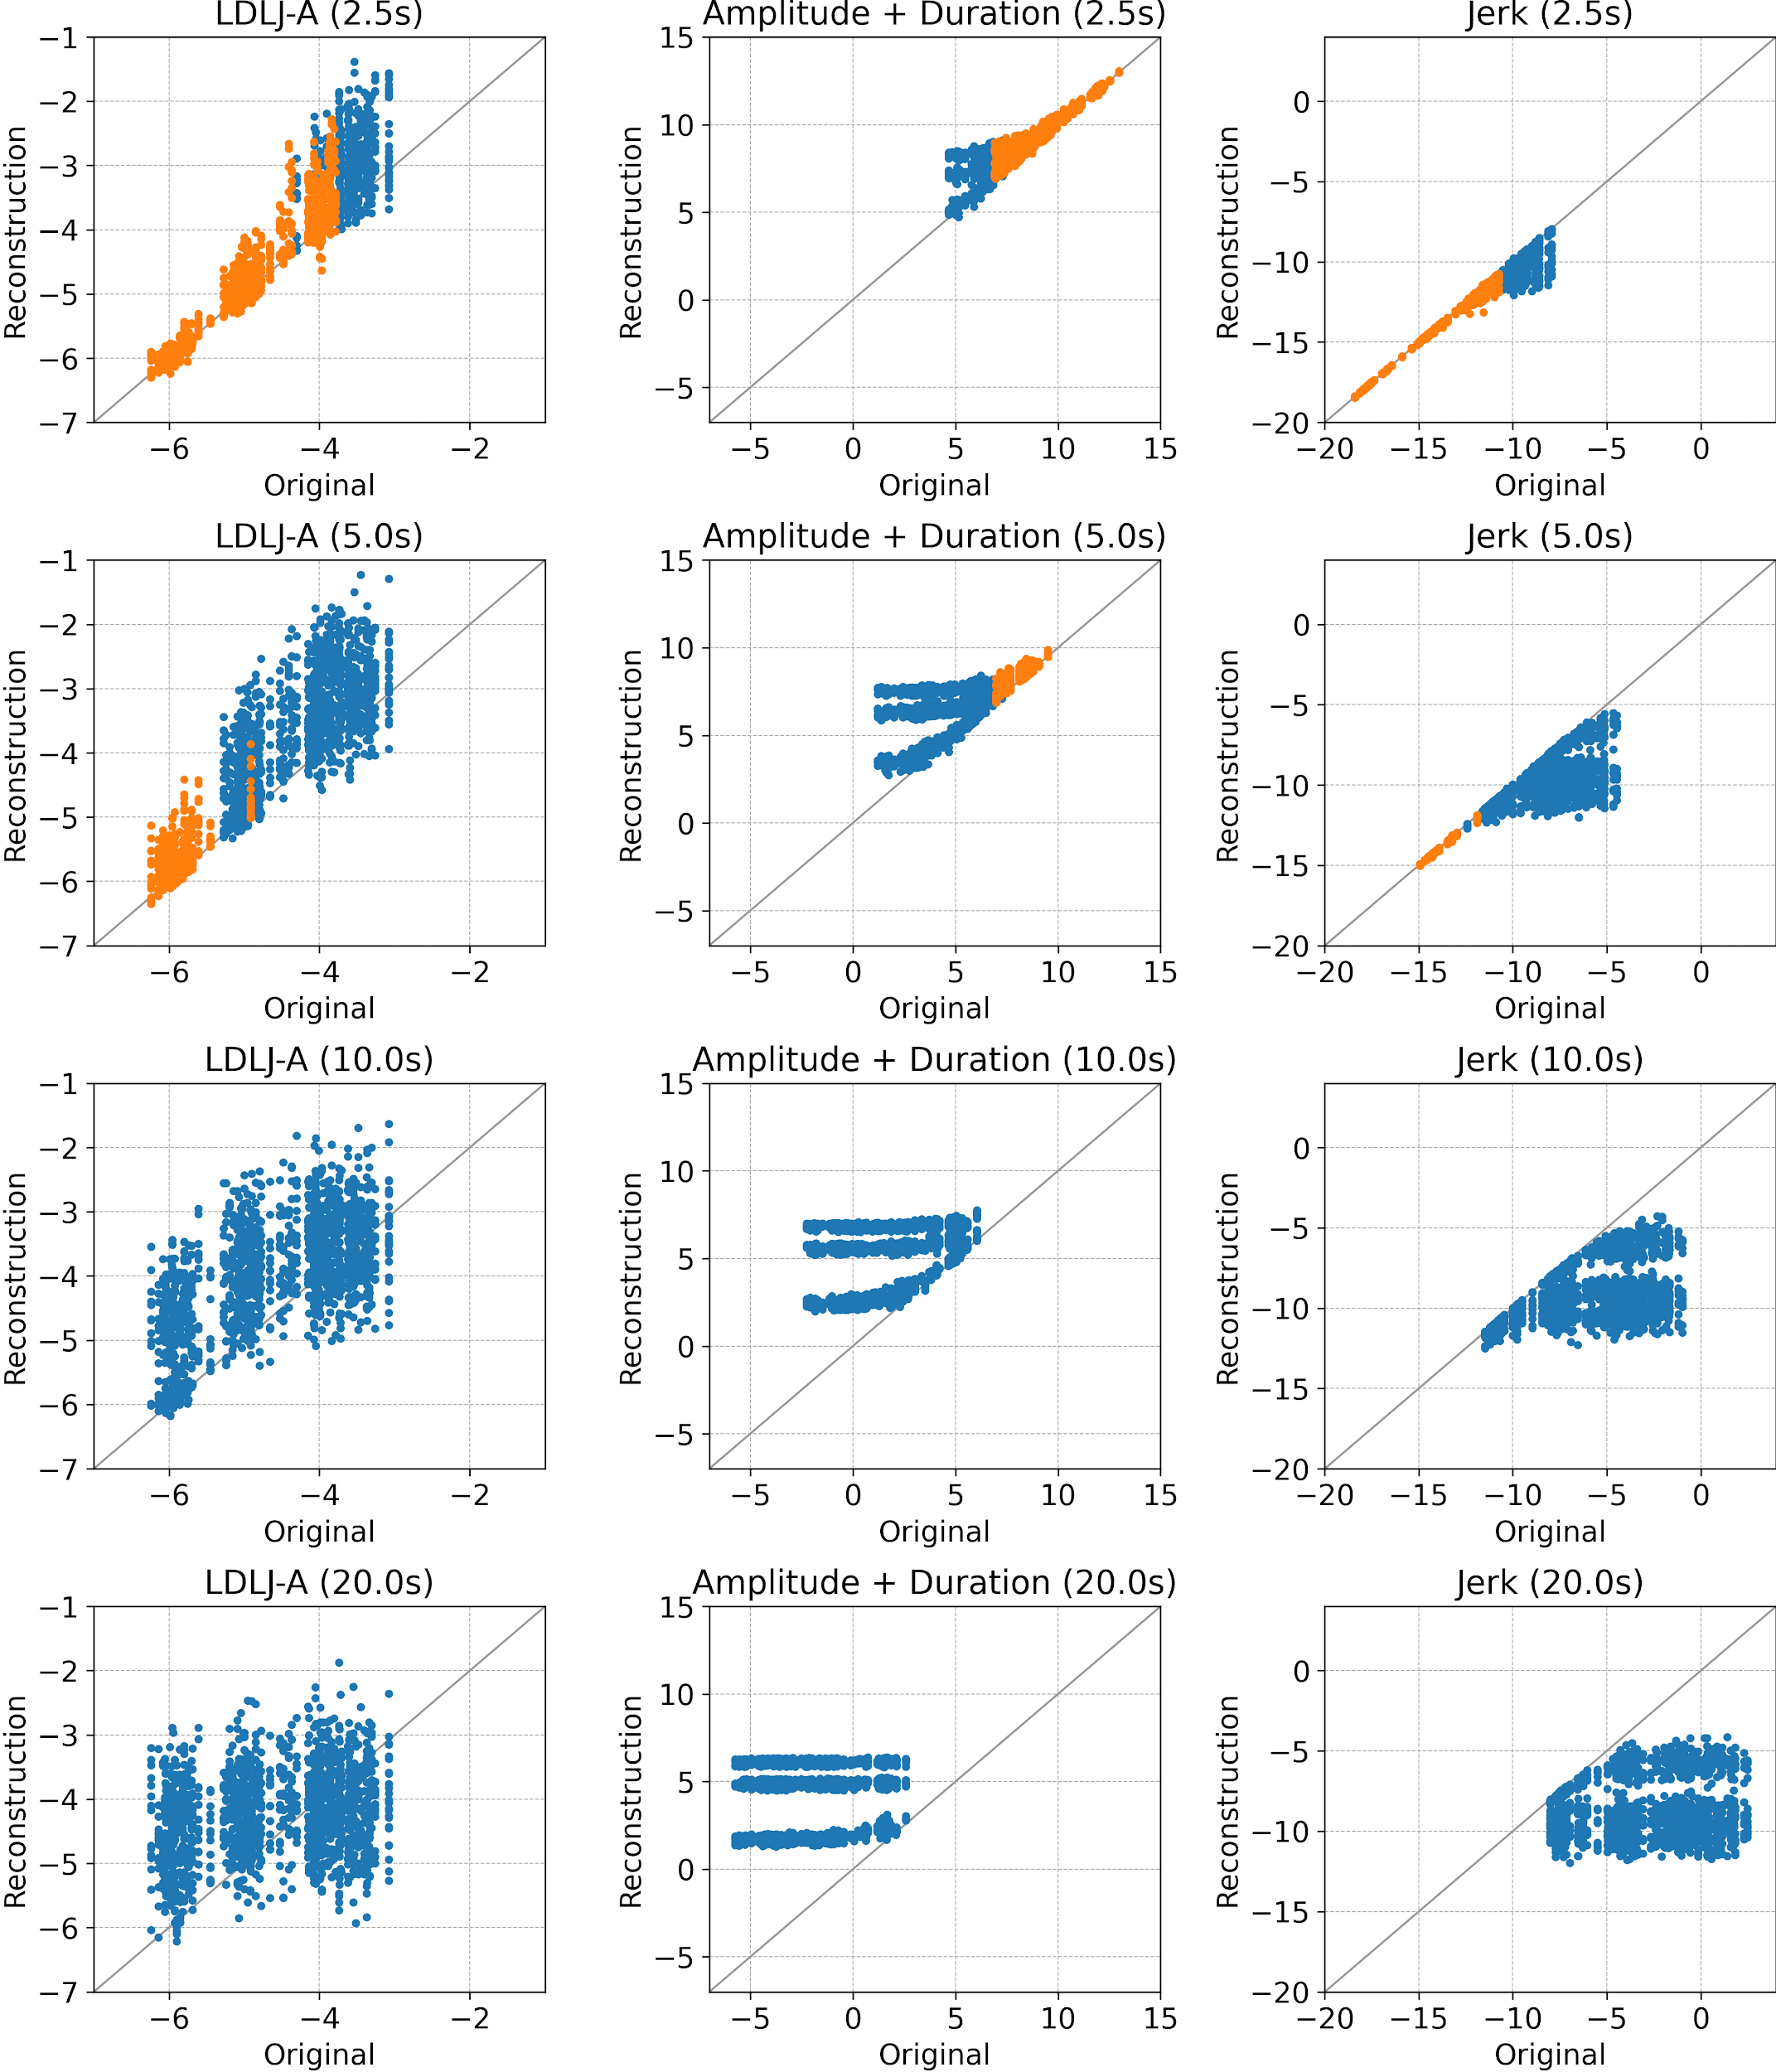
LDLJ-A terms
The effect of the relative amplitude of linear acceleration with respect to gravity.
Orange dots are movements with SGR >= 1.05
A movement duration increases, we are only quantifying the smoothness of the reconstruction error term.

Slide 7
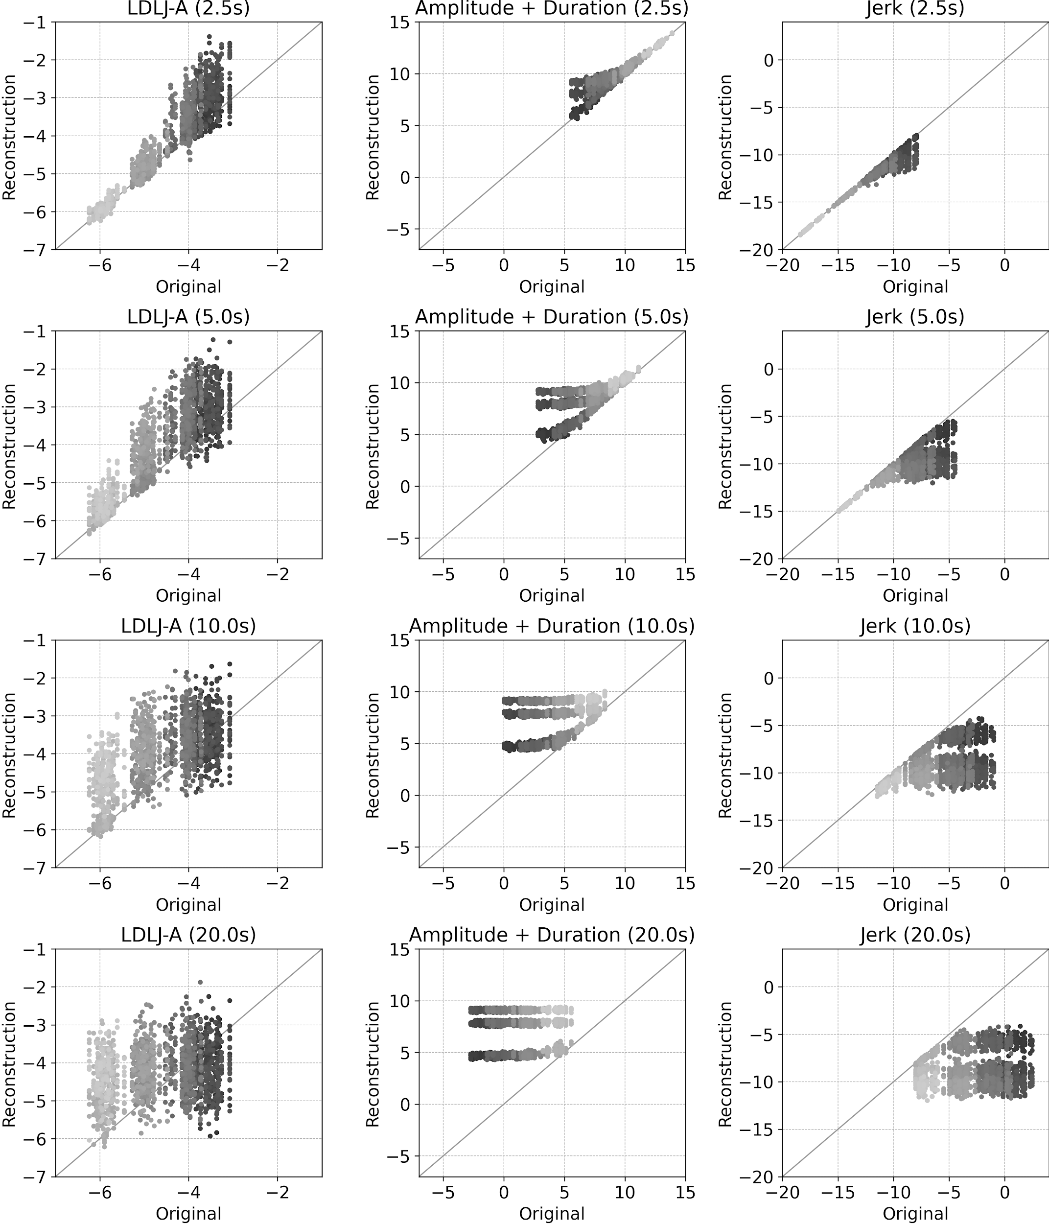
LDLJ-A terms
The effect of the relative amplitude of linear acceleration with respect to gravity.
Orange dots are movements with SGR >= 1.05
A movement duration increases, we are only quantifying the smoothness of the reconstruction error term.

Slide 8
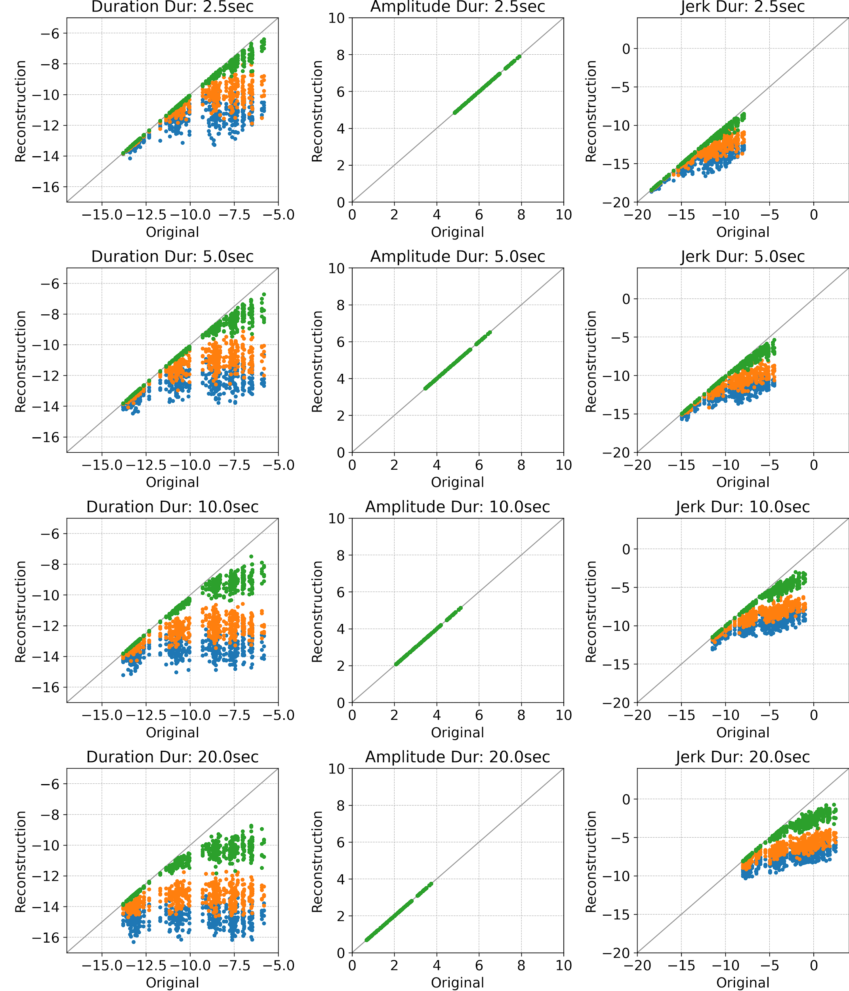
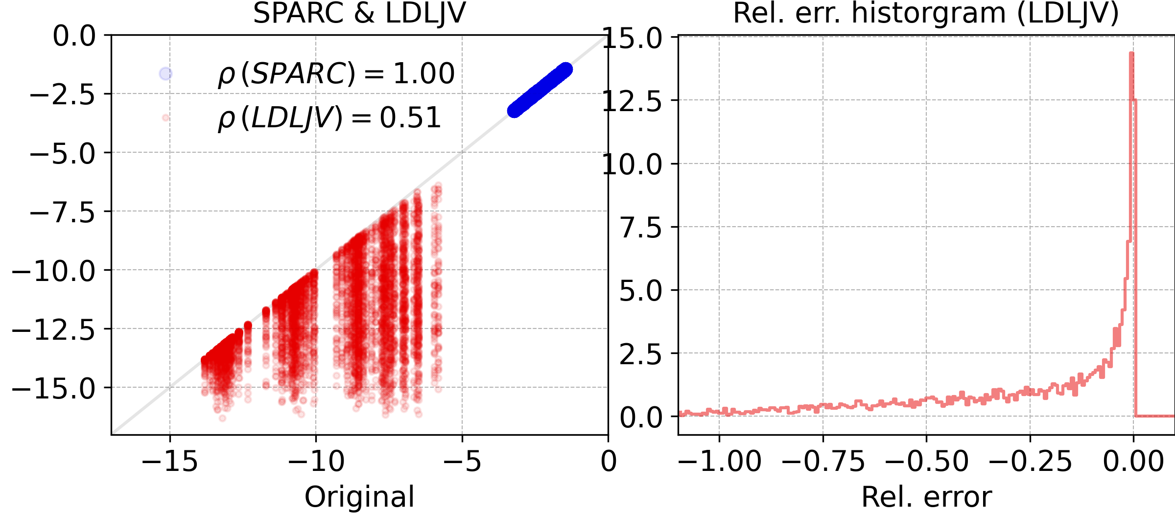
LDLJ-V Gyro

